Slide 1

Python as An Additional Language
Lesson 7: Virtual Environments, serving up the data

Slide 2
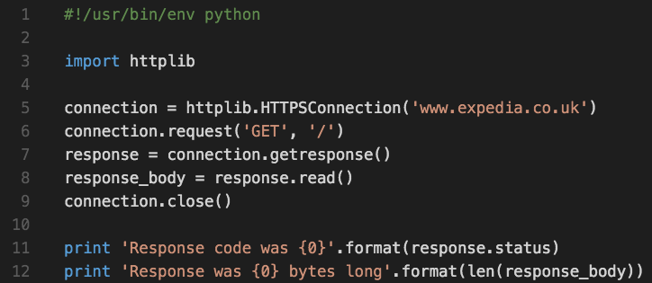

Last Time

Slide 3
Pip Installs Packages
Python Package Index: https://pypi.python.org/pypi
To install a package:
pip install <packagename>
You know what’s coming…

Slide 4
Pip Installs Packages
Python Package Index: https://pypi.python.org/pypi
To install a package:
pip install <packagename>
You know what’s coming…
There’s a problem using pip - what is it?

Slide 5
Version Conflicts, System conflicts
What happens if
program A needs version 1 of a module
Program B needs (incompatible) version 2 of the same module
The solution: virtualenv
pip install virtualenv

Slide 6
Creating a new virtual environment
OS X:
virtualenv lesson7
source lesson7/bin/activate
Windows:
virtualenv lesson7
lesson7\Scripts\activate
Your prompt will change to reflect you’ve started your virtual environment

Slide 7
Using our virtual environment
We’re going to need a new module for the rest of today’s class:
Activate your virtual environment if you haven’t already
Install the module “web.py” (that’s its literal name)

Slide 8
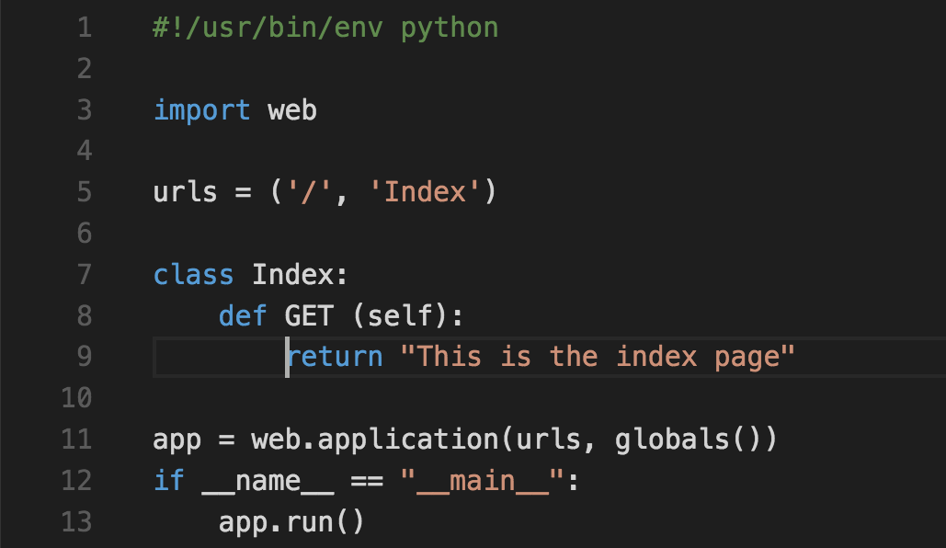
Building a web server

Slide 9
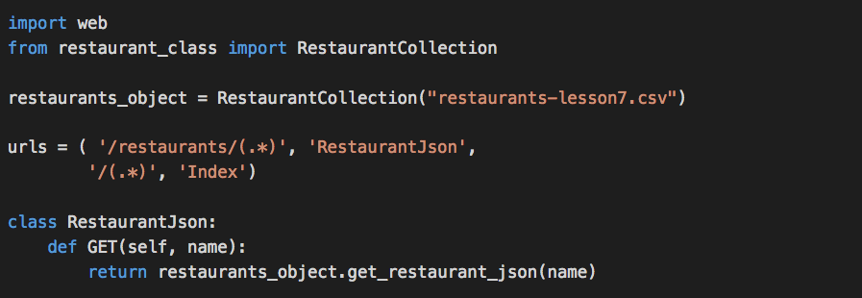
Passing Request data in

Slide 11
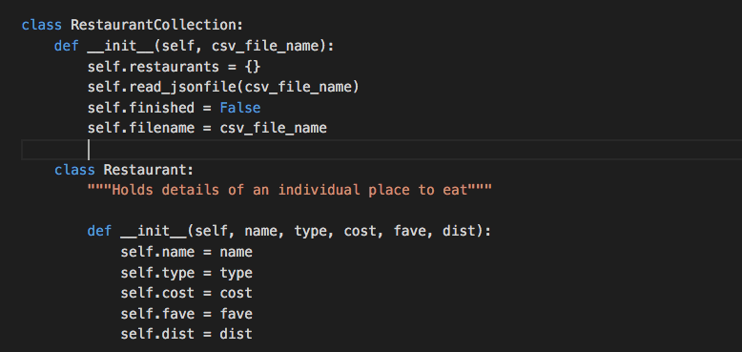
Nested classes

Slide 12
Exercise
Download the code from http://go/dkthpsj7
Add an extra method to the RestaurantCollection class that takes the name of a restaurant and returns the object as JSON
Call that method from your webserver so that you can get a JSON object with full restaurant details by visiting:
http://127.0.0.1:8080/restaurants/pret (for example)

Slide 13
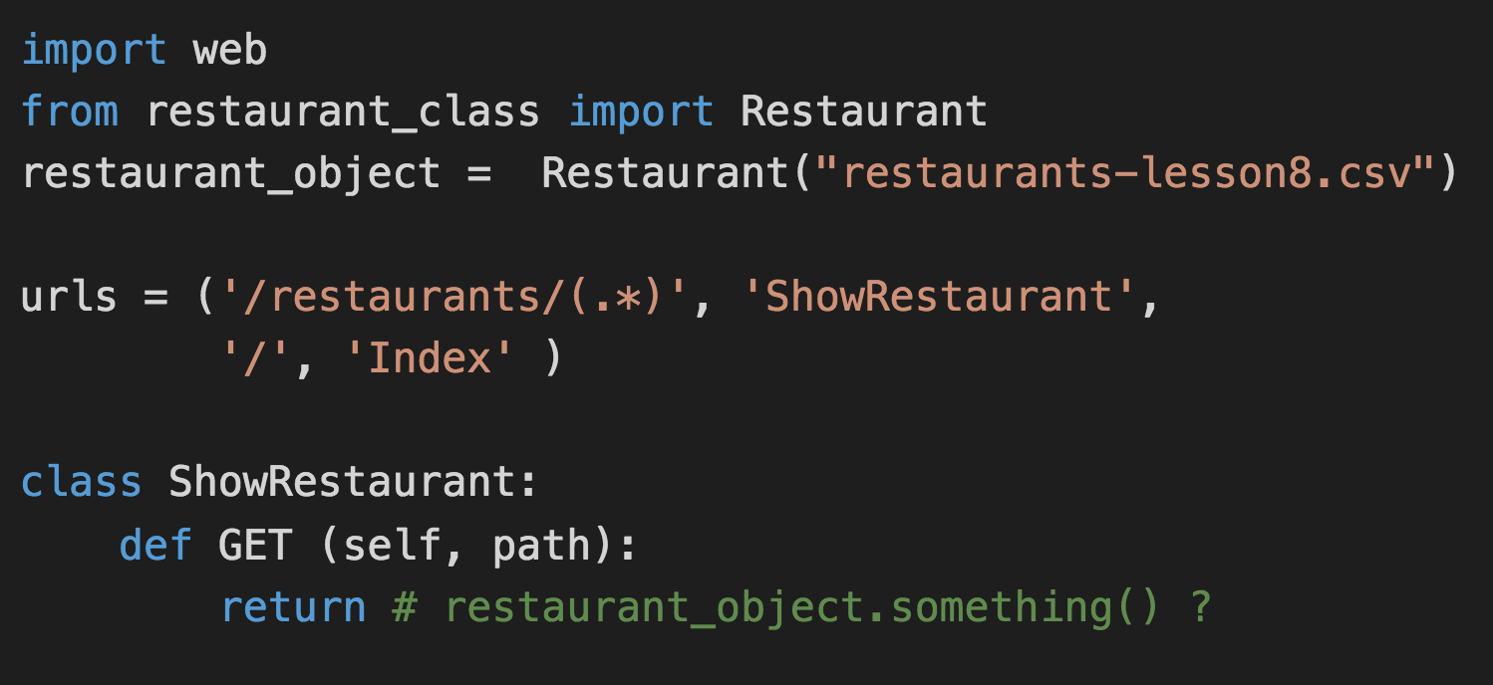
Hints

Slide 14
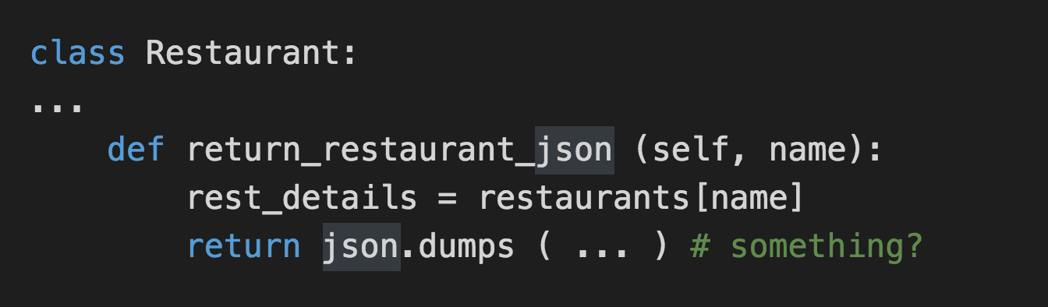
Hints

Slide 15
Extra Credit / Homework
Add an extra method to your webserver:
http://127.0.0.1:8080/score/<num>
Should return a JSON object listing all the restaurants with a matching score
Got that working? Add a /max_dist URL to your service

